Slide 1
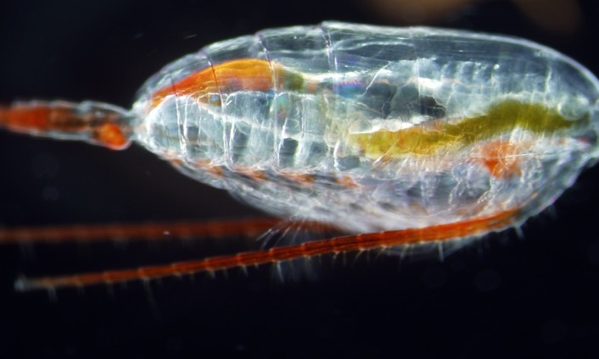
ADAC Year 7 Annual Meeting ...Via Conference Call, 2-3 June 2021
ADAC Project Briefing
Mitigating the Damage to Arctic Copepods from Surface Oil Spills: When to Apply Dispersants.
PI: Dr. Christoph Aeppli, caeppli@bigelow.org
Co-PI: Dr. David Fields, dflelds@bigelow.org
Technicians: Maura Niemisto, Erin Beirne
Project Champion: CAPT Kirsten R. Trego
Advisory Group: Dr. Robyn Conmy, EPA
Greg Hall, USCG Academy
Sarah Allan, NOAA
1 mm

Slide 2
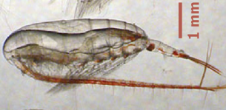
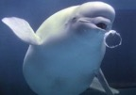



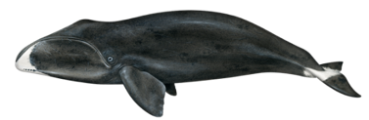





Copepods are the base of the Arctic food web.
ADAC Program Year 7 Annual Meeting 2-3 June 2021
Copepods
Calanus (adults) are 73% - 80% fat
Calanus species are a main driver of
mesozooplankton biomass (80%)
Years with high copepod biomass correlates with high fish recruitment
Walrus
Beluga Whale
Polar Bear
Ringed Seal
Bow Whale
Arctic Cod
Alaskan Salmon
Pollock
Char
Arctic Tern
Copepod
Species: Calanus
Lipid-rich
Overwinter at depth
Fish Recruitment
Copepod Biomass
Notes:
Copepods are the bottom of the LIPID base of the food web
Copepods are 75% fat
Good copepod years = good fish years

Slide 3
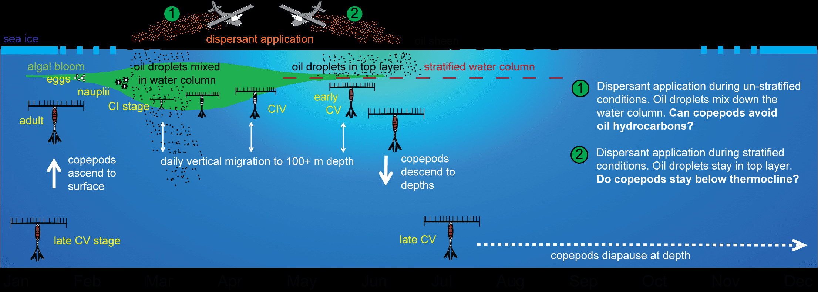
Copepods have complex life cycles and active behavior patterns
ADAC Program Year 7 Annual Meeting 2-3 June 2021
J F M A M J J A S O N D
Notes:
Copepods have complex life cycles and Movement patterns.
Copepods like many Arctic animals sleep through the winter. The reside at 1/2km +depth. Sometime in March they wake up, molt to become adults, mate and send the eggs off to the surface. On the way up they hatch into nauplii stages.
As the ice melts and sun hits the upper ocean, the phytoplankton bloom and the copepods feed and grow.
April/May they begin to vertically migrate – these can be 50-100m/day
June/July the water column becomes stratified with a strong temperature gradient with depth
September the pre-adults go back down (500m) for diapause.

Slide 4

Mitigating the Damage to Arctic Copepods from Surface Oil Spills: When to Apply Dispersants.
ADAC Program Year 7 Annual Meeting 2-3 June 2021
Walrus
Beluga Whale
Polar Bear
Ringed Seal
Research Questions
Can copepods sense and avoid dissolved or dispersed (particulate) oil?
Are copepods spatially separated from dispersed oil during a stratified water column?
Bow Whale
Arctic Cod
Alaskan Salmon
Pollock
Char
Arctic Tern

Slide 5
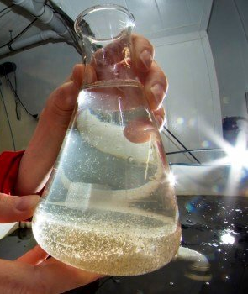
Mitigating the Damage to Arctic Copepods from Surface Oil Spills: When to Apply Dispersants.
ADAC Program Year 7 Annual Meeting 2-3 June 2021
Research Questions
Can copepods sense and avoid dissolved or dispersed (particulate) oil?
Are copepods spatially separated from dispersed oil during a stratified water column?
Notes:
Previous study have confined copepods to a uniform Oil Concentration.

Slide 6
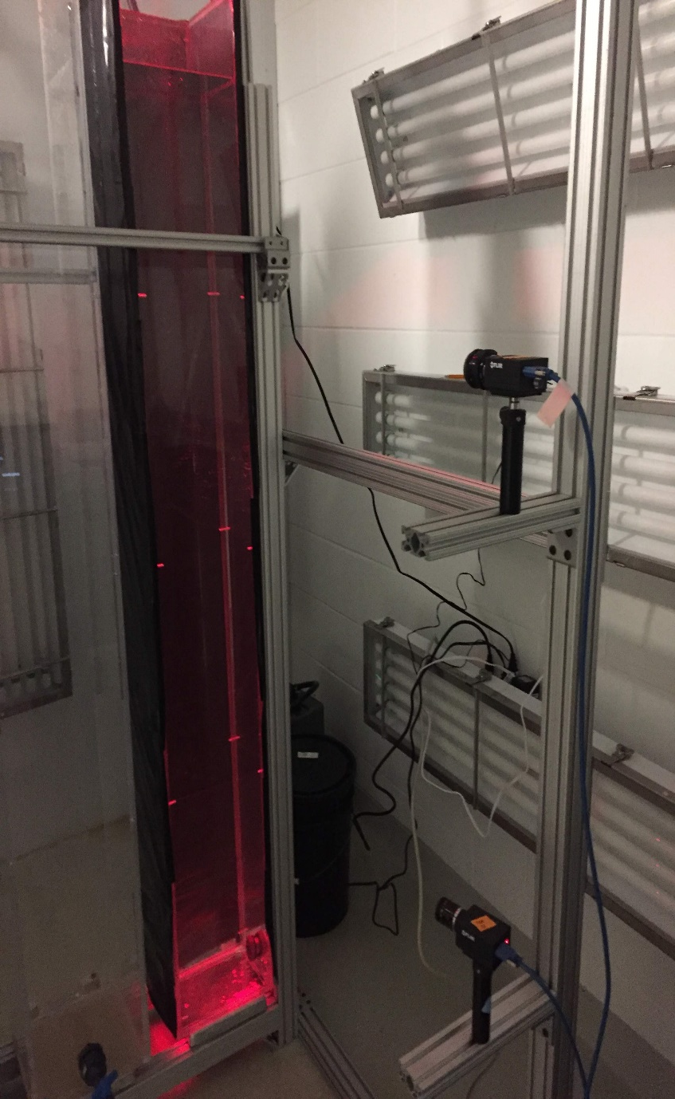
Mitigating the Damage to Arctic Copepods from Surface Oil Spills: When to Apply Dispersants.
ADAC Program Year 7 Annual Meeting 2-3 June 2021
Research Questions
Can copepods sense and avoid dissolved or particulate oil?
Are copepods spatially separated from dispersed oil during a stratified water column?
Notes:
We have designed our experiments to allow copepods to move away from/towards the oil.

Slide 7
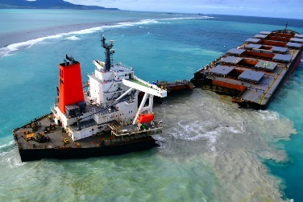



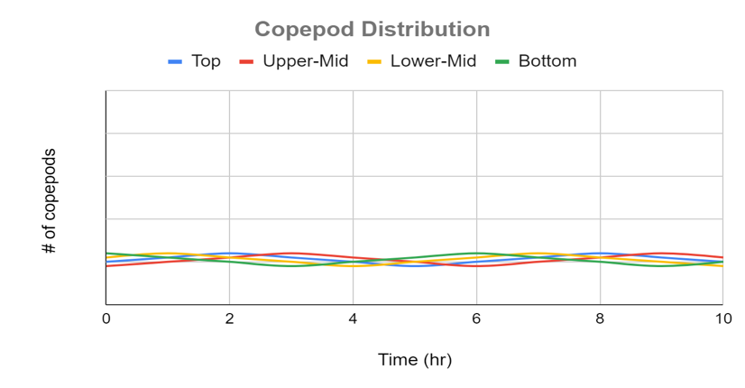
Experimental System
ADAC Program Year 7 Annual Meeting 2-3 June 2021
1
2
3
5
4
6
4 cameras – each visualize 10 l
Video recorded at 1 Hz simultaneously from all cameras
Lighting is done using IR lights
Oil concentration measured from 5 sampling ports

Slide 8
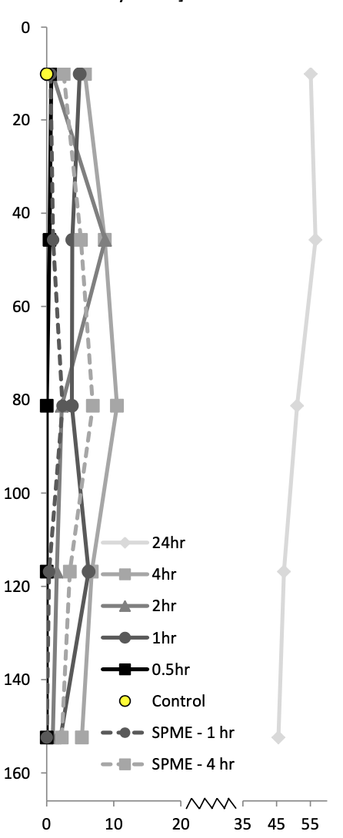
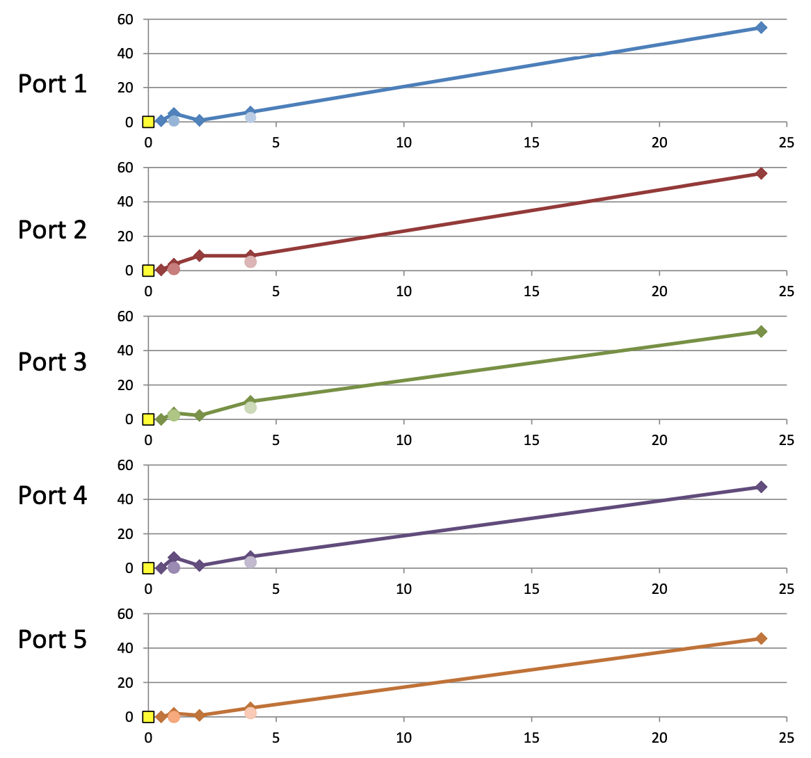
Results: oil only, no dispersants
ADAC Program Year 7 Annual Meeting 2-3 June 2021
PAH vertical profile
PAH conc vs time
Camera
C1
C2
C3
C4
Port
P1
P2
P3
P4
P5
PAH conc (ug/L)
time after oil addition (h)

Slide 9
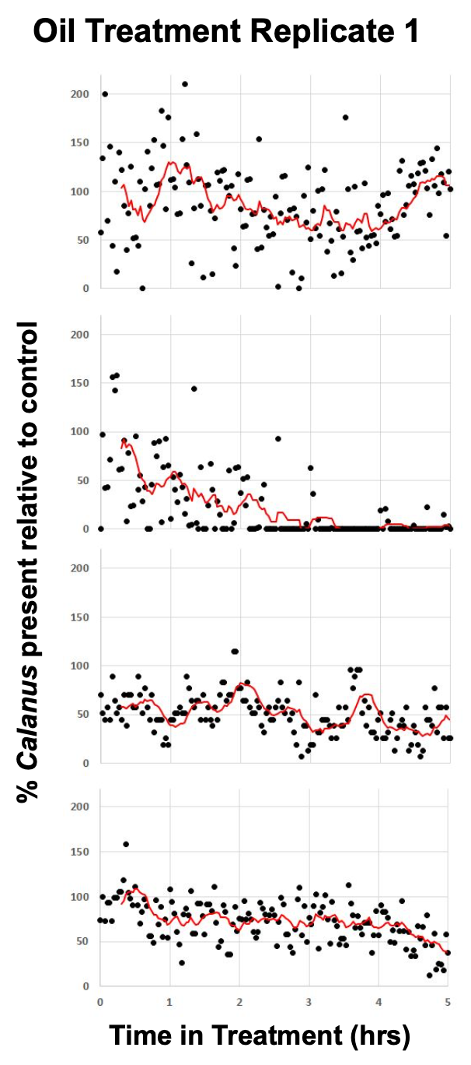
Results: oil only, no dispersants
ADAC Program Year 7 Annual Meeting 2-3 June 2021
PAH vertical profile
PAH conc vs time
Camera
C1
C2
C3
C4
Port
P1
P2
P3
P4
P5
PAH conc (ug/L)
time after oil addition (h)

Slide 10
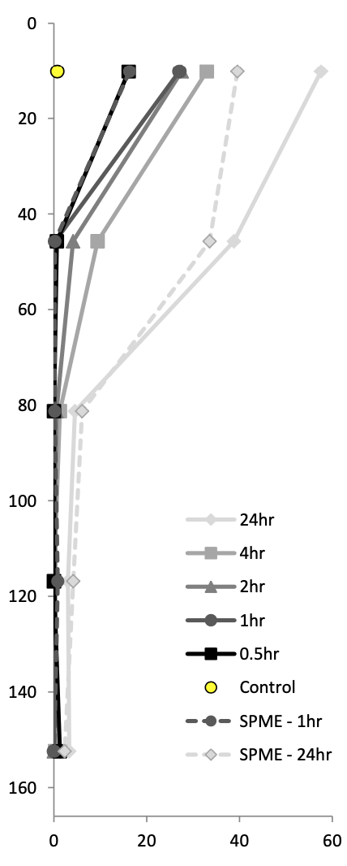
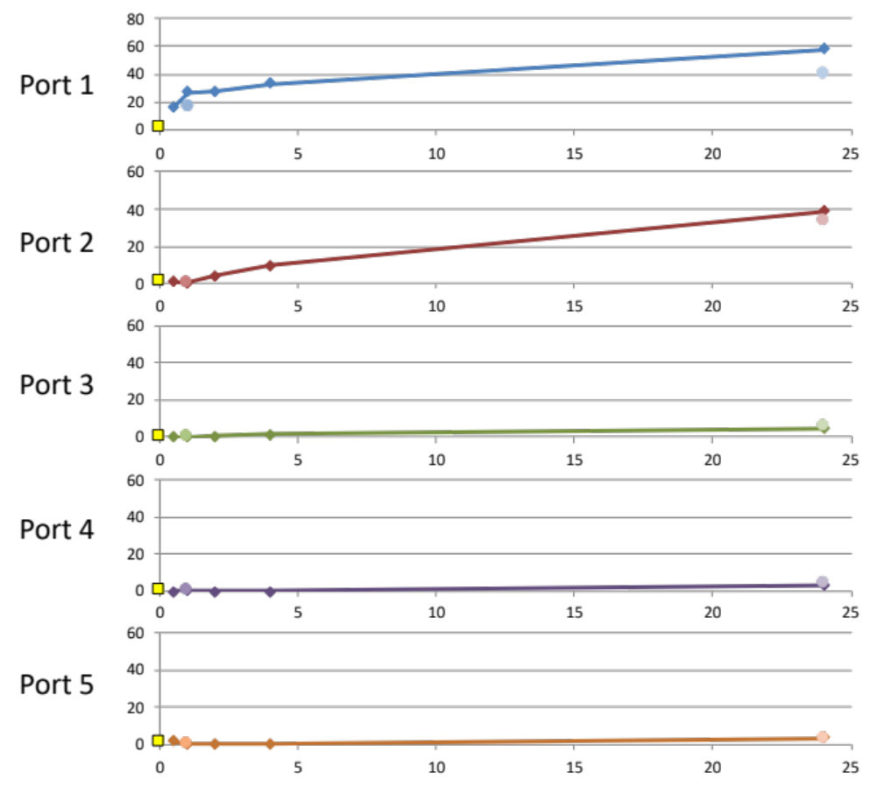
Results: oil only, no dispersants: noteworthy replicate.
ADAC Program Year 7 Annual Meeting 2-3 June 2021
PAH vertical profile
PAH conc vs time
Camera
C1
C2
C3
C4
Port
P1
P2
P3
P4
P5
PAH conc (ug/L)
time after oil addition (h)

Slide 11
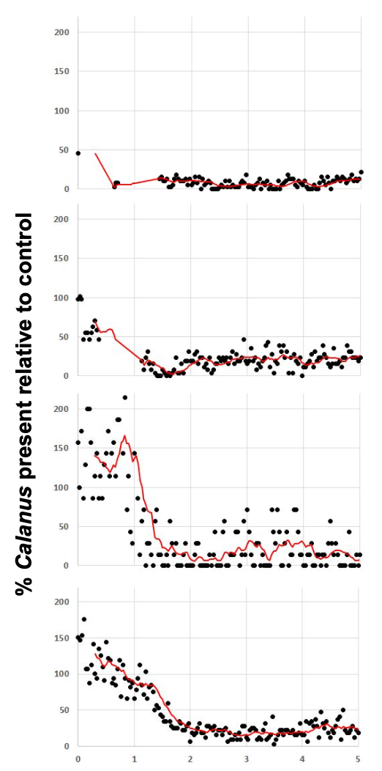
Results: oil only, no dispersants: noteworthy replicate.
ADAC Program Year 7 Annual Meeting 2-3 June 2021
PAH vertical profile
PAH conc vs time
Camera
C1
C2
C3
C4
Port
P1
P2
P3
P4
P5
PAH conc (ug/L)
time after oil addition (h)

Slide 12
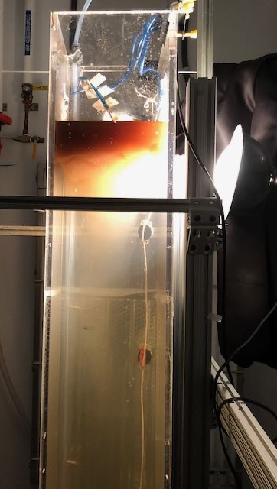
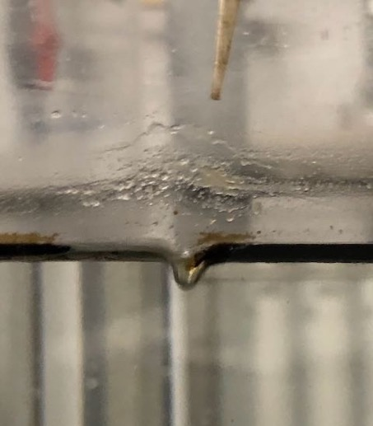
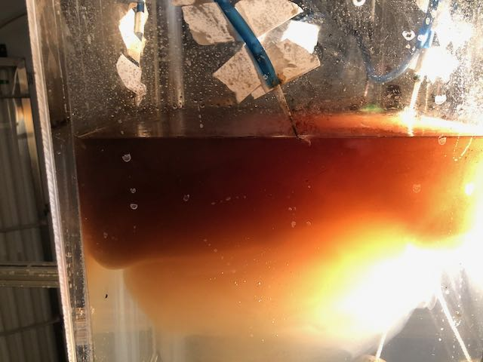
ADAC Program Year 7 Annual Meeting 2-3 June 2021
Adding dispersant: formation of oil droplets
Determine the influence of dispersant on the vertical movement of copepod
added airstream as energy to disperse oil
oil/dispersant mixture rapidly disperses, and forms a “cloud” that travels down the column within approx. 6 hours

Slide 13
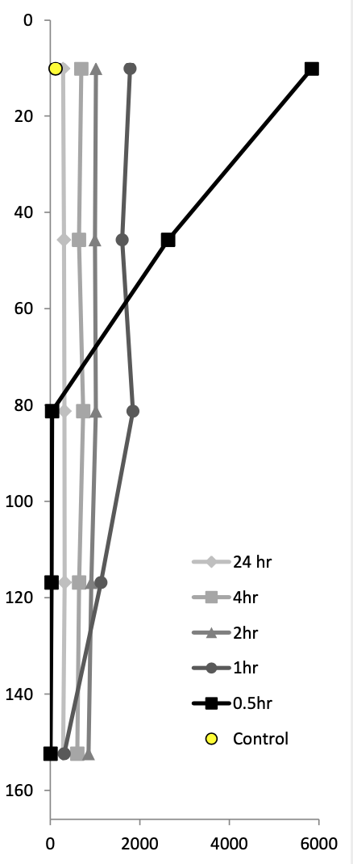
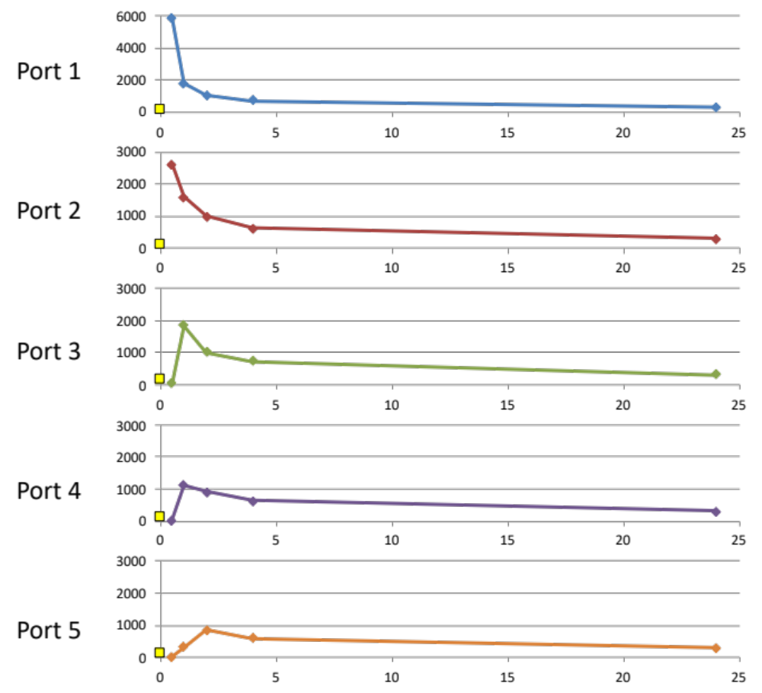
Results: oil/dispersant
ADAC Program Year 7 Annual Meeting 2-3 June 2021
PAH vertical profile
PAH conc vs time
Camera
C1
C2
C3
C4
Port
P1
P2
P3
P4
P5
PAH conc (ug/L)
time after oil addition (h)

Slide 14
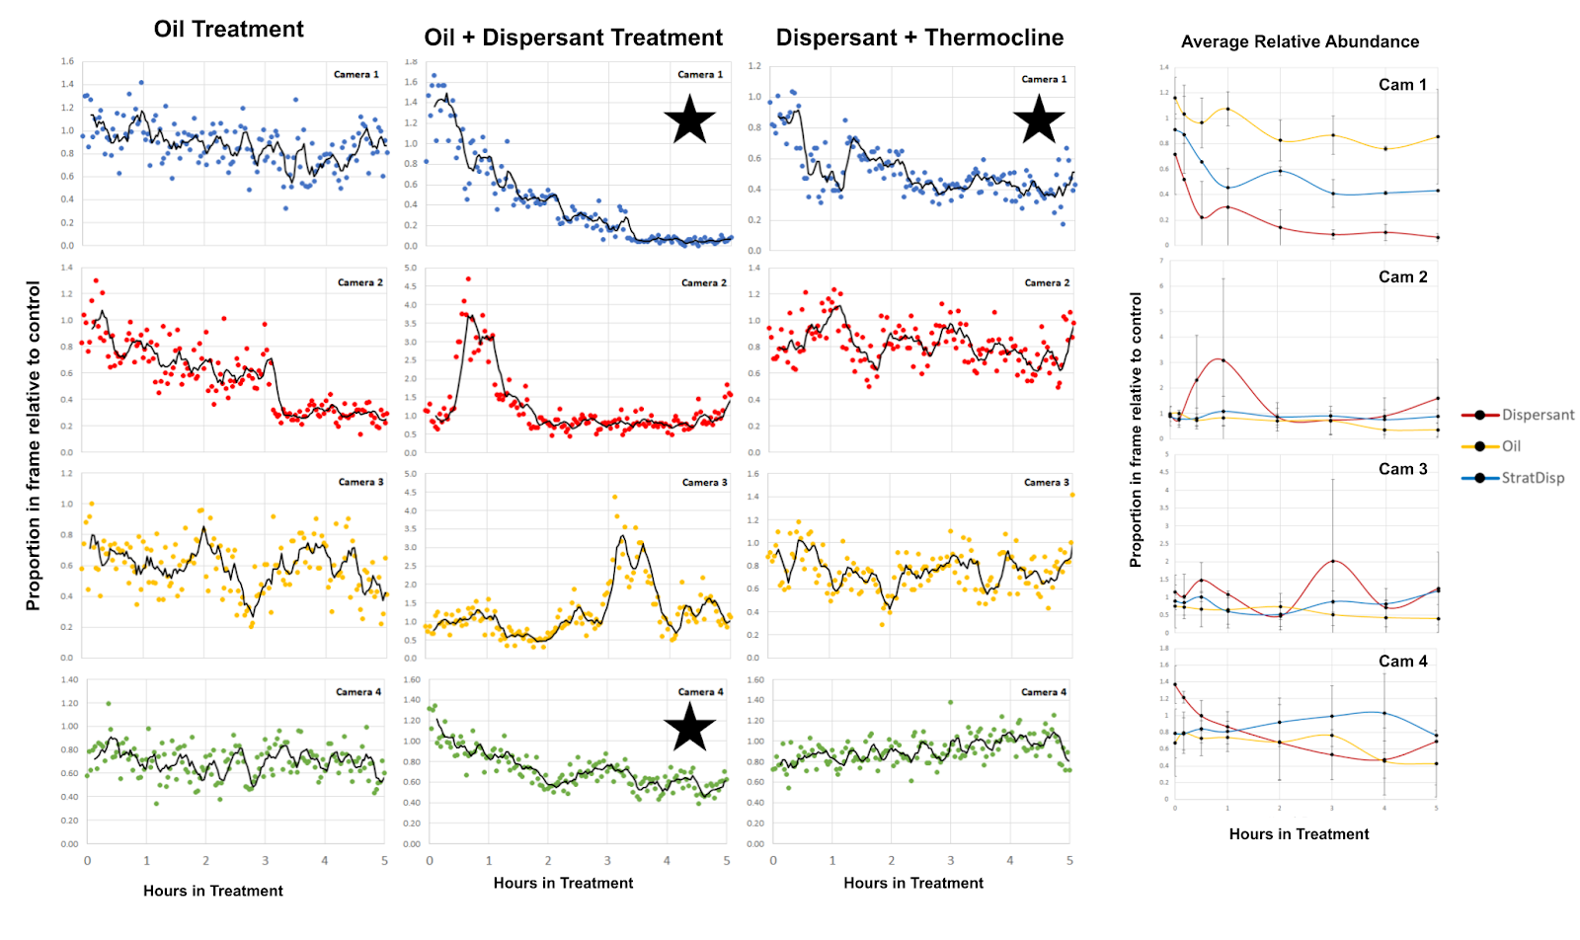
Results: oil/dispersant
ADAC Program Year 7 Annual Meeting 2-3 June 2021
PAH vertical profile
Camera
C1
C2
C3
C4
Port
P1
P2
P3
P4
P5
PAH conc (ug/L)
time after oil addition (h)

Slide 15
Summary
ADAC Program Year 7 Annual Meeting 2-3 June 2021
Oil Only
Dispersed Oil
Oil only:
Oil profile
slow mass transfer vs vertical mixing,
concentrations low,
<10 ug/L, around detection limit, sub-lethal (lower than 96h-LC50 values)
final conc. approx.
60 ug/
With Dispersants
Oil profile:
fast peak conc.
>1,000 ug/L,
above 96h LC50-range
then progressively lower conc.
final conc: approx.
290 ug/L
Notes:
Oil Only Treatment. Oil concentrations start out low and slowly increase over time as the oil constituents enter the water column.
w/Dispersants. Oil quickly moves into the water and to a much greater depth. Oil levels reach high concentration which decrease over time.
***Oil Concentrations are always 10-100X of those in Oil Only Treatments.

Slide 16
Summary
ADAC Program Year 7 Annual Meeting 2-3 June 2021
Oil Only
Dispersed Oil
Oil only:
Oil profile
slow mass transfer vs vertical mixing,
concentrations low,
<10 ug/L, around detection limit, sub-lethal (lower than 96h-LC50 values)
final conc. approx.
60 ug/
Copepods
Response within hours on surface. Lower depth: slow or no response
With Dispersants
Oil profile:
fast peak conc.
>1,000 ug/L,
above 96h LC50-range
then progressively lower conc.
final conc: approx.
290 ug/L
Copepods
rapid response, immediate
Copepod react to oil. The response to dispersed oil is faster and more intense than to oil without dispersant.

Slide 17
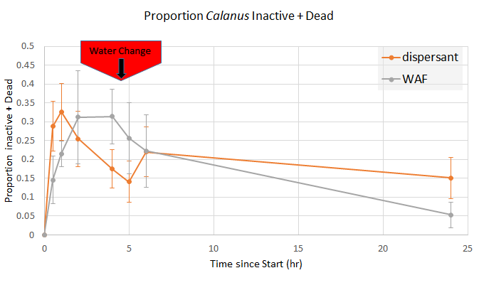
ADAC Program Year 7 Annual Meeting 2-3 June 2021
What is the fate of copepods after interacting with oil?
Small-scale experiment to investigate the type of response by copepods to oil
In agreement with tower experiment: inactivation (sinking) of copepods within 2h
Copepods recover when transferred into clean water (“water change”)
dissolved oil - 150 ug PAHs/L
dispersed oil treatment - 340 ug PAHs/L
In clean water, copepods can recover over short time scales.
Long-term impact?

Slide 18
Thermocline Experiments
ADAC Program Year 7 Annual Meeting 2-3 June 2021
Warm
Cold
Notes:
Designed experiments simulating summer stratification to see if:
1) Oil remained confined in the upper water column
2) Copepods above the thermocline would cross the thermocline to escape the oil

Slide 19
Thermocline Experiments
ADAC Program Year 7 Annual Meeting 2-3 June 2021
Warm
Cold

Slide 20
Summary/Conclusions
ADAC Program Year 7 Annual Meeting 2-3 June 2021
Copepods move in response to the oil, even at sub-lethal levels
Adding dispersants increases the copepod’s response
Copepods that sink have the ability to recover in clean water over a short time scale (24h)
A stratified water column decreases the copepods response.
Follow-up questions: Oil droplets can attach to copepods
what are longer-term effects of oil droplet attachment? (>24h)
Do attached oil droplets lead to oil accumulation in copepod lipids? (bioaccumulation, implication for higher tropic levels)
How do other organisms react to oil (larval stages of fish, crab, etc.)
Transition: We will seek other funding sources to use our system to address these questions.
Notes:
Bullet 1/2 – Copepods can avoid oil and if exposed they can recover.
Previous studies may have over estimated the toxic effects of oil on copepods
#3 Dispersants increase the negative effects by a) increasing the oil concentrations b) bringing the oil deeper in the water
#4 Oil attaches to the copepods and is ingested by the copepods. This has the potential for greater impact on higher trophic levels.

Slide 21
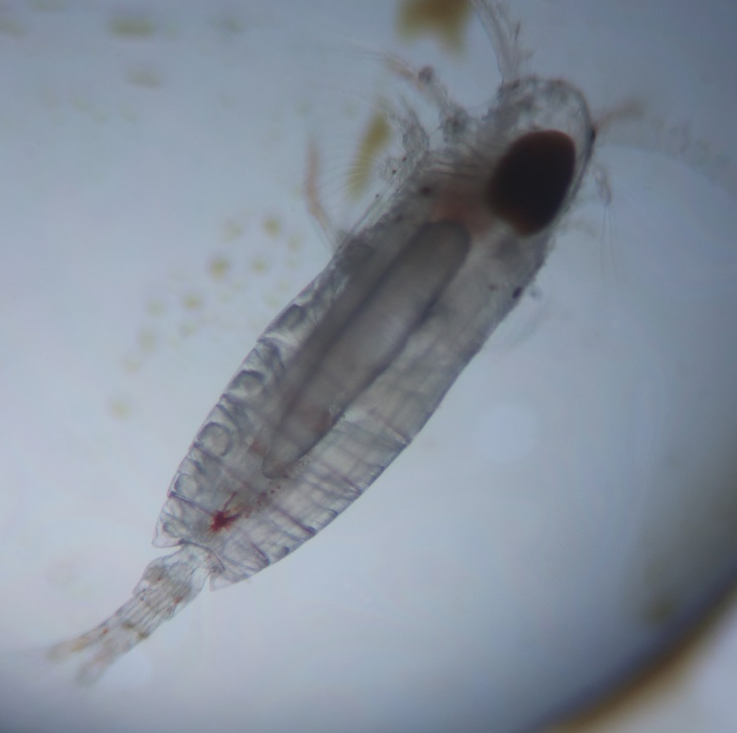
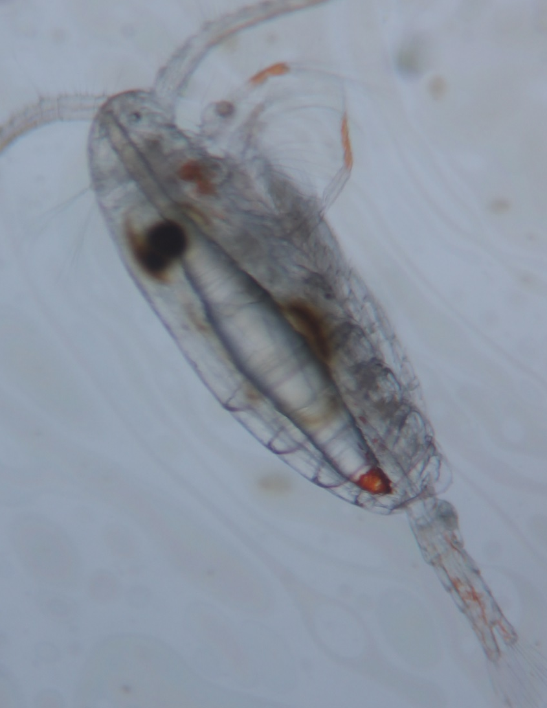
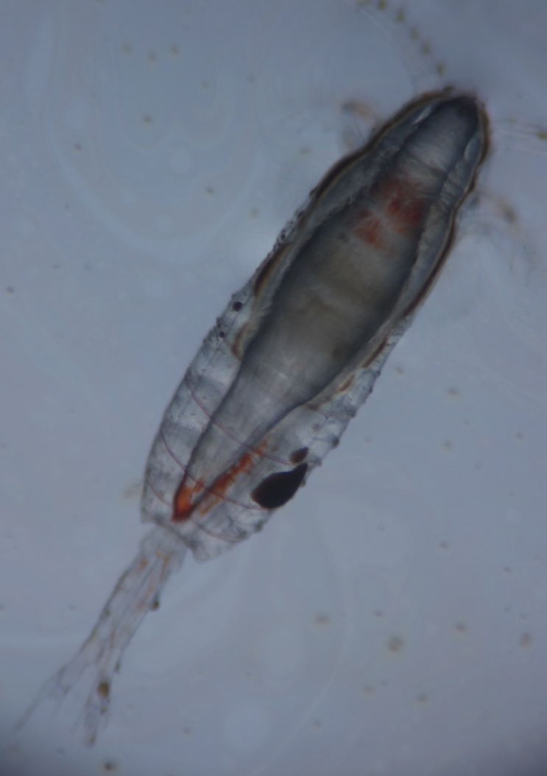
Copepods with Oil
ADAC Program Year 7 Annual Meeting 2-3 June 2021

Slide 22
Summary/Conclusions
ADAC Program Year 7 Annual Meeting 2-3 June 2021
Copepods move in response to the oil, even at sub-lethal levels
Adding dispersants increases the copepod’s response
Copepods that sink have the ability to recover in clean water over a short time scale (24h)
A stratified water column decreases the copepods response.
Follow-up questions: Oil droplets can attach to copepods
what are longer-term effects of oil droplet attachment? (>24h)
Do attached oil droplets lead to oil accumulation in copepod lipids? (bioaccumulation, implication for higher tropic levels)
How do other organisms react to oil (larval stages of fish, crab, etc.)
Transition: We will seek other funding sources to use our system to address these questions.

Slide 23
Achievements YEAR 7
ADAC Program Year 7 Annual Meeting 2-3 June 2021
October-November:
  Phase II: Data evaluation
  Phase III: Thermocline experiments - analyze video data
December-January
  Phase II: Chemical analysis and data evaluation: Thermocline experiments (oil/dispersant)
February-Present
  Phase I/II: Synthesize data for manuscripts and final reports

Slide 24
plans for remainder of YEAR 7
ADAC Program Year 7 Annual Meeting 2-3 June 2021
Finalize data analysis; identify potential data gaps, that could be filled with limited additional experiments (late spring/summer)
Manuscript I: effect of undispersed and dispersed oil on copepod movement → knowledge product
Manuscript II: Movement and copepods and dispersed oil in a stratified water column mesocosm → knowledge project
Final report of project → knowledge product
Transition: ADAC and Project Investigators will provide Knowledge Products to Project Champion (and designated advisors). In collaboration with Dr. Pat Tomco, we will design a decision tree of when to deploy dispersants (based on copepods/mussels).

Slide 25
ADAC Year 7 Annual Meeting ADAC Project Briefing
Mitigating the Damage to Arctic Copepods from Surface Oil Spills: When to Apply Dispersants.
1 mm
……..END…….
Student Participation
PI: Dr. Christoph Aeppli, caeppli@bigelow.org
Co-PI: Dr. David Fields, dflelds@bigelow.org
Technicians: Maura Niemisto, Erin Beirne
Project Champion: CAPT Kirsten R. Trego
Advisory Group: Dr. Robyn Conmy, EPA
Greg Hall USCG Academy Sarah Allan NOAA
Cameron Carlson – ADAC Fellow/REU Student
Sam McNeely – ADAC Fellow/REU Student
Manasi Desai – Summer/Fall Intern

